Slide 1
FAEN 301: Numerical Methods
Lecture 2: Taylor and McLaurin Series, System of Linear Equations and solutions
Dr. Nii Longdon Sowah
October 2023

Slide 2


Slide 3
Lecture outline
Definition of Convergence and Stability
Taylor’s Theorem and Taylor’s Series
Maclaurin series
Alternating series theorem
Review of vectors and matrices
System of linear equations and solutions
Naïve Gaussian elimination
Gauss-Jordan elimination
LU Decomposition

Slide 4

convergence
For iterative numerical techniques, convergence is whether the approximations move closer to the true value for a reasonable number of iterations.
Consider the following sequences, which one converges to 0 faster for k = 0, 1, 2, …, n?
$$\frac{1}{2^{k}}= 1, \frac{1}{2}, \frac{1}{4}, \frac{1}{8}, \frac{1}{16}$$
$$\frac{1}{k+1}= 1, \frac{1}{2}, \frac{1}{3}, \frac{1}{4}, \frac{1}{5}$$

Slide 5
stability
A numerical technique is stable if a bounded input provides a bounded output.
Small fluctuations in the input should not cause a huge deviation from the expected or true answer.
Numerical techniques that are proven not to magnify approximation errors are said to be stable.

Slide 6
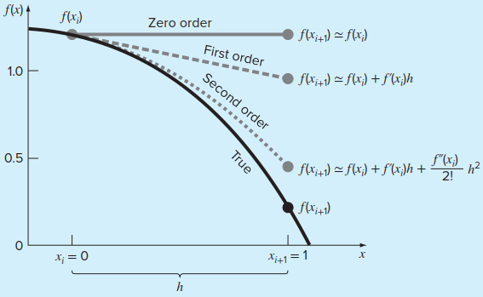
Taylor’s series
The Taylor theorem states that any smooth function can be approximated as a polynomial.
The Taylor series then provides a means to express this idea mathematically in a form that can be used to generate practical results
The approximation of
at x = 1 by
zero-order, first-order, and second-order Taylor series expansions

Slide 7

Taylor’s series
A useful way to gain insight into the Taylor series is to build it term by term
It follows zero-order approximation which states that the value of f at the new point is the same as the value at the old point

Slide 8




Taylor’s series
Use Taylor series expansions with n = 0 to 6 to approximate
on the basis of the value of f (x) and its derivatives at . Note that this means that
Solution
We determine the correct value
What is the relative error?

Slide 9




Taylor’s series
For the first-order approximation, we add the first derivative term where
What is the the percent relative error for the first order?
For the second-order approximation, we add the second derivative

Slide 10
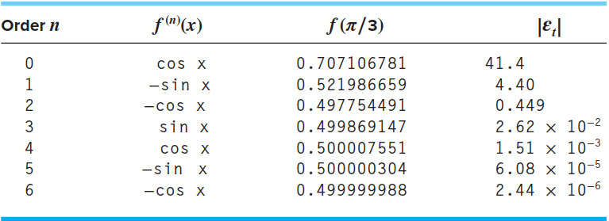
Taylor’s series

Slide 11
Maclaurin Series
The MacLaurin series is special case of Taylor series centered at zero: a = 0.

Slide 12

Maclaurin Series Example 1
Obtain the Maclaurin series expansion of $f\left(x\right)=e^{x}$.

Slide 13

Maclaurin Series Example 1
Obtain the Maclaurin series expansion of $f\left(x\right)=e^{x}$.

Slide 14

Maclaurin Series Example 2
Obtain the Maclaurin series expansion of $f\left(x\right)=sin⁡(x)$.

Slide 15
Maclaurin Series Example 2
Obtain the Maclaurin series expansion of $f\left(x\right)=sin⁡(x)$.

Slide 16

Maclaurin Series Example 3
Obtain the Maclaurin series expansion of $f\left(x\right)=cos⁡(x)$.

Slide 17
Maclaurin Series Example 4

Slide 18
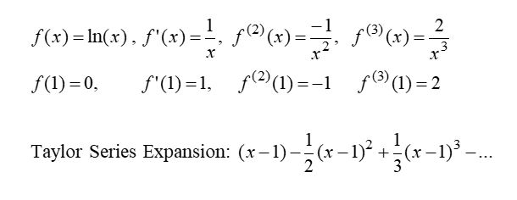

Taylor Series Example
Obtain the Taylor series expansion of $f\left(x\right)=ln(x)$ at$a=1$.

Slide 19
Convergence of Taylor series
The Taylor series converges fast (few terms are needed) when x is near the point of expansion. If |x-a| is large, then more terms are needed to get a good approximation.

Slide 20
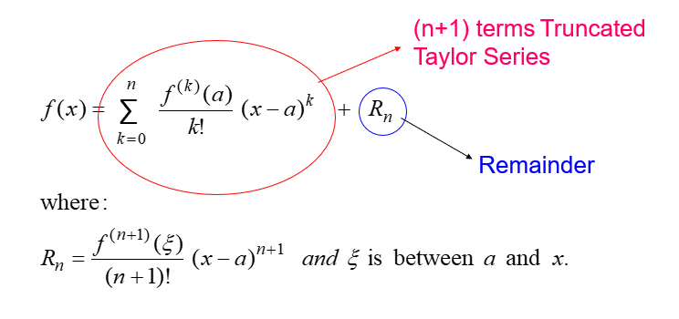

Taylor’s theorem
If a function $f\left(x\right)$ has derivatives of orders 1, 2, 3, … (n+1) on an interval containing $a$ and $x$, then the value of $f(x)$ is given by:

Slide 21
Taylor’s theorem

Slide 22

The remainder/error term
How large is the error if we replaced $f\left(x\right)=e^{x}$ by the first 4 terms (n=3) of its Taylor series expansion for a = 0 and x = 0.2?

Slide 23
Alternating series theorem

Slide 24
Alternating series theorem - example

Slide 25
Review exercise

Slide 27
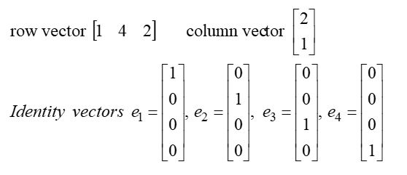
vectors
Vector: a one-dimensional array of numbers.
Examples:

Slide 28
matrices
All these special matrix forms have different properties

Slide 29
matrices

Slide 30
Determinant of a matrix

Slide 31
Addition and multiplication of matrices

Slide 32
System of linear equations

Slide 33
solutions of linear equations
A system of linear equations may have
A unique solution
Infinite solutions
No solutions
A system with a unique solution

Slide 34

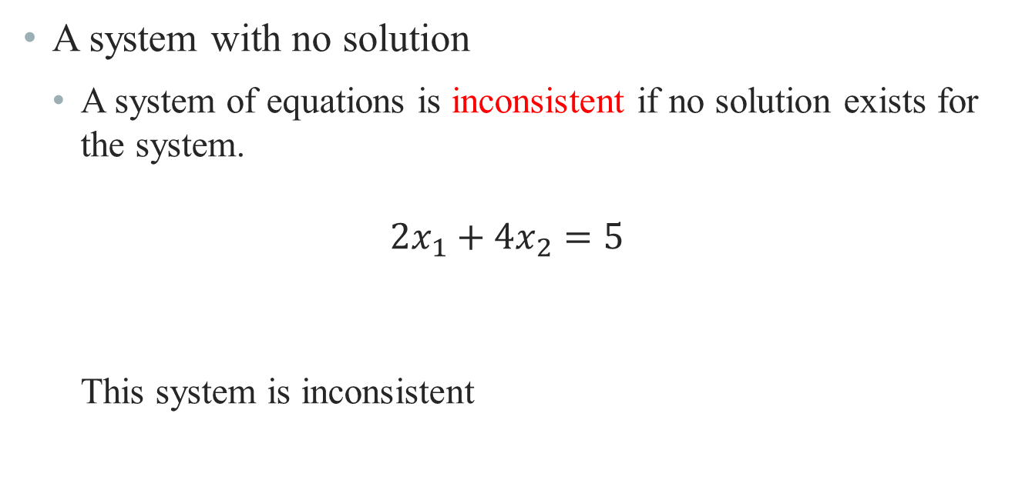



Solutions of linear equations
A system with no solution
A system of equations is inconsistent if no solution exists for the system.
$$2x_{1}+4x_{2}=5$$
This system is inconsistent
$$x_{1}+2x_{2}=3$$
$$x_{1}=3−2x_{2}$$
$$2\left(3−2x_{2}\right)+4x_{2}=5$$
$$−4x_{2}+4x_{2}=−1$$

Slide 35
Solutions of linear equations
Some systems have infinite solutions

Slide 36
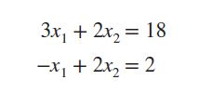
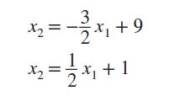
Graphical Solutions of linear equations
Solutions can be found by plotting each equation and finding points of intersection.
We re-write the equations to take the form of equations of a straight line as:

Slide 37
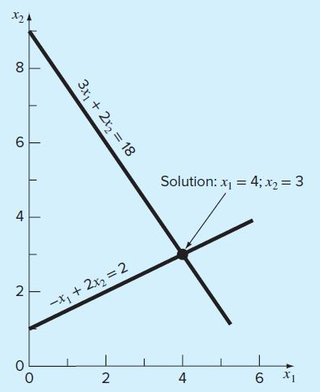
Graphical Solutions of linear equations

Slide 38


Augmented matrices
A matrix derived from a system of linear equations (each written in standard form with the constant term on the right) is the augmented matrix of the system
x – 2y + 3z = 9 System –x + 3y + z = – 2 2x – 5y +5z = 17
Augmented Matrix:
$$\begin{matrix} 1 & −2 & 3 \\ −1 & 3 & 1 \\ 2 & −5 & 5\end{matrix}$$
$$\begin{matrix} 9 \\ −2 \\ 17\end{matrix}$$

Slide 39
coefficient matrices
A matrix derived from a system of linear equations (each written in standard form without the constant term on the right) is the coefficient matrix of the system
x – 2y + 3z = 9 System –x + 3y + z = – 2 2x – 5y +5z = 17
Coefficient Matrix:
$$\begin{matrix} 1 & −2 & 3 \\ −1 & 3 & 1 \\ 2 & −5 & 5\end{matrix}$$

Slide 40
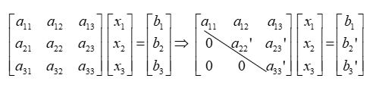
Naïve gaussian elimination
This technique is used to solve a system of linear equations
The method consists of 2 steps.
Forward elimination: reducing the system to the upper triangular form using basic operations (additions and multiplications)
Backward substitution: solving the system from the last variable.

Slide 41
Naïve gaussian elimination
The basic operations include:
Multiplying one of the rows by a non-zero constant.
Adding a multiple of one row to another
Interchanging rows

Slide 42



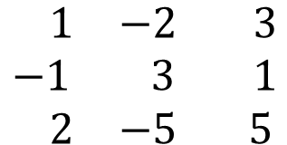
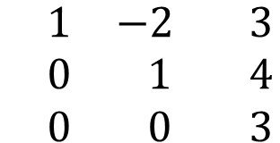




EXAMPlE 1 (FORWARD ELIMINATION)
Solve the system below using gaussian elimination
x – 2y + 3z = 9 –x + 3y + z = – 2 2x – 5y +5z = 17
$$\begin{matrix} 1 & −2 & 3 \\ −1 & 3 & 1 \\ 2 & −5 & 5\end{matrix}$$
$$\begin{matrix} 9 \\ −2 \\ 17\end{matrix}$$
$$\begin{matrix} 1 & −2 & 3 \\ 0 & 1 & 4 \\ 0 & −1 & −1\end{matrix}$$
$$\begin{matrix} 9 \\ 7 \\ −1\end{matrix}$$
$R1+R$2
$$−2R1+R3$$
$$\begin{matrix} 1 & −2 & 3 \\ 0 & 1 & 4 \\ 0 & 0 & 3\end{matrix}$$
$$\begin{matrix} 9 \\ 7 \\ 6\end{matrix}$$
$R2+R$3

Slide 43



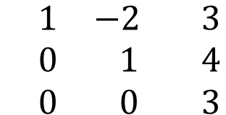

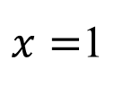




EXAMPlE 1 (backward substitution)
$$\begin{matrix} 1 & −2 & 3 \\ 0 & 1 & 4 \\ 0 & 0 & 3\end{matrix}$$
$$\begin{matrix} 9 \\ 7 \\ 6\end{matrix}$$
$$3z=6$$
$$y+4z=7$$
$$x−2y+3z=9$$
$$z=2$$
$$y=7−4(2)$$
$$x−2(−1)+3(2)=9$$
$$y=−1$$
$x=$1

Slide 44



Example 2 (forward elimination)
$$−2R1+R2$$
$−\frac{1}{2}R1+R$3
$$R1+R4$$

Slide 45



Example 2 (forward elimination)
$$−3R2+R3$$
$\frac{1}{2}R2+R$4
$−2R3+R$4

Slide 46
Example 2 (forward elimination)

Slide 47
Example 2 (backward substitution)

Slide 48
determinant

Slide 49
Number of Solutions to a system
A system of linear equations can have a unique solution,
infinite solutions or no solution.
Some properties help to identify the type of solution a system has:

Slide 50
Number of Solutions to a system

Slide 51
Gauss-Jordan elimination
The method reduces the general system of equations
AX=B to IX=B’
where I is an identity matrix
Only Forward elimination is done, and no backward substitution is needed.
It takes 50% more time than Naive Gaussian method.

Slide 52

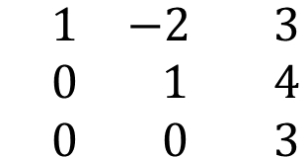
Gauss-Jordan elimination
In the previous example for solving:
x – 2y + 3z = 9 –x + 3y + z = – 2 2x – 5y +5z = 17
We arrived at the augmented matrix:
$$\begin{matrix} 1 & −2 & 3 \\ 0 & 1 & 4 \\ 0 & 0 & 3\end{matrix}$$
$$\begin{matrix} 9 \\ 7 \\ 6\end{matrix}$$

Slide 53



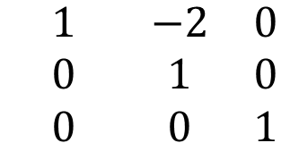
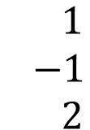
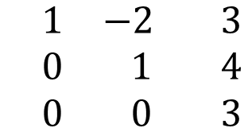

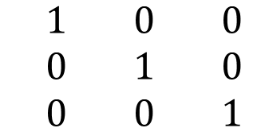


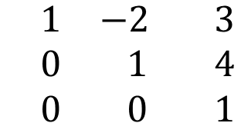

Gauss-Jordan elimination
We continue the elimination to obtain a 3x3 identity matrix:
$$\begin{matrix} 1 & −2 & 3 \\ 0 & 1 & 4 \\ 0 & 0 & 3\end{matrix}$$
$$\begin{matrix} 9 \\ 7 \\ 6\end{matrix}$$
$$\begin{matrix} 1 & −2 & 3 \\ 0 & 1 & 4 \\ 0 & 0 & 1\end{matrix}$$
$$\begin{matrix} 9 \\ 7 \\ 2\end{matrix}$$
$$\frac{1}{3}R3$$
$$\begin{matrix} 1 & −2 & 0 \\ 0 & 1 & 0 \\ 0 & 0 & 1\end{matrix}$$
$$\begin{matrix} 3 \\ −1 \\ 2\end{matrix}$$
-3$R3+R1$
-4$R3+R$2
$$\begin{matrix} 1 & 0 & 0 \\ 0 & 1 & 0 \\ 0 & 0 & 1\end{matrix}$$
$$\begin{matrix} 1 \\ −1 \\ 2\end{matrix}$$
2$R2+R1$

Slide 54

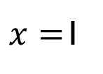
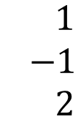
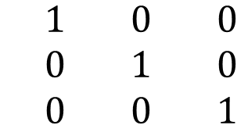
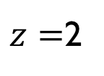
Gauss-Jordan elimination
$$\begin{matrix} 1 & 0 & 0 \\ 0 & 1 & 0 \\ 0 & 0 & 1\end{matrix}$$
$$\begin{matrix} 1 \\ −1 \\ 2\end{matrix}$$
This implies:
$x=$1
$y=$ -1
$z=$2

Slide 55

Lower-upper (Lu) decomposition
For a system of linear equations: $Ax=B$, the idea behind LU decomposition is to:
Break down matrix $A=LU$ such that:
Lower triangular matrix
Upper triangular matrix

Slide 56

Lower-upper (Lu) decomposition
$Ax=B$ becomes
$$LUX=B$$
Let
$$UX=Y$$
Then solve
$LY=B$ and $UX=Y$

Slide 57

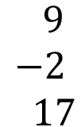

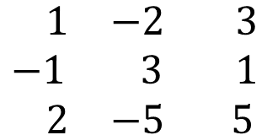
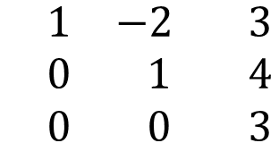


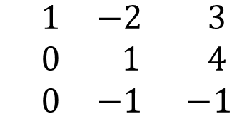

Lu decomposition – example 1
Solve the system below using LU decomposition
x – 2y + 3z = 9 –x + 3y + z = – 2 2x – 5y +5z = 17
Use Gaussian Elimination to obtain upper triangular matrix
$$\begin{matrix} 1 & −2 & 3 \\ −1 & 3 & 1 \\ 2 & −5 & 5\end{matrix}$$
$$\begin{matrix} 9 \\ −2 \\ 17\end{matrix}$$
$$\begin{matrix} 1 & −2 & 3 \\ 0 & 1 & 4 \\ 0 & −1 & −1\end{matrix}$$
$$\begin{matrix} 9 \\ 7 \\ −1\end{matrix}$$
$R1+R$2
$$−2R1+R3$$
$$\begin{matrix} 1 & −2 & 3 \\ 0 & 1 & 4 \\ 0 & 0 & 3\end{matrix}$$
$$\begin{matrix} 9 \\ 7 \\ 6\end{matrix}$$
$R2+R$3

Slide 58



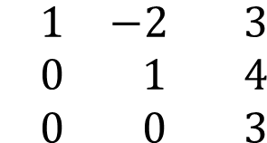
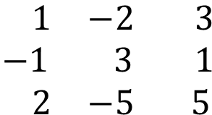
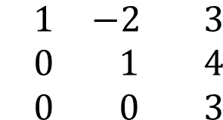



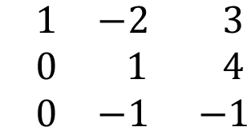

Lu decomposition – example 1
Negate multiplying coefficients and use them to form lower triangular matrix
$$\begin{matrix} 1 & −2 & 3 \\ −1 & 3 & 1 \\ 2 & −5 & 5\end{matrix}$$
$$\begin{matrix} 9 \\ −2 \\ 17\end{matrix}$$
$$\begin{matrix} 1 & −2 & 3 \\ 0 & 1 & 4 \\ 0 & −1 & −1\end{matrix}$$
$$\begin{matrix} 9 \\ 7 \\ −1\end{matrix}$$
$1 R1+R$2
$$−2 R1+R3$$
$$\begin{matrix} 1 & −2 & 3 \\ 0 & 1 & 4 \\ 0 & 0 & 3\end{matrix}$$
$$\begin{matrix} 9 \\ 7 \\ 6\end{matrix}$$
$1 R2+R$3
$$\begin{matrix}1 & 0 & 0 \\ −1 & 1 & 0 \\ 2 & −1 & 1\end{matrix}$$
$$\begin{matrix} 1 & −2 & 3 \\ 0 & 1 & 4 \\ 0 & 0 & 3\end{matrix}$$
Lower triangular matrix
Upper triangular matrix

Slide 59
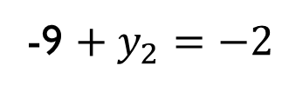
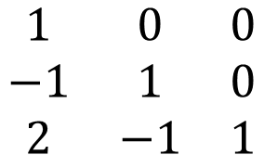









Lu decomposition – example 1
Solve for $LY=B$
$$\begin{matrix}1 & 0 & 0 \\ −1 & 1 & 0 \\ 2 & −1 & 1\end{matrix}$$
$$\begin{matrix}y_{1} \\ y_{2} \\ y_{3}\end{matrix}$$
$$\begin{matrix}9 \\ −2 \\ 17\end{matrix}$$
=
$$y_{1}=9$$
$${−y}_{1}+y_{2}=−2$$
${2y}_{1}−y_{2}+y_{3}=$17
-9 $+ y_{2}=−2$
$18−7+y_{3}=$17
$$y_{2}= 7$$
$y_{3}=$6

Slide 60












Lu decomposition – example 1
Solve for $UX=$Y
$$\begin{matrix} 1 & −2 & 3 \\ 0 & 1 & 4 \\ 0 & 0 & 3\end{matrix}$$
$$\begin{matrix}x_{1} \\ x_{2} \\ x_{3}\end{matrix}$$
$$\begin{matrix}9 \\ 7 \\ 6\end{matrix}$$
=
$$3x_{3}=6$$
$$x_{2}+4x_{3}=7$$
$$x_{1}−2x_{2}+3x_{3}=9$$
$$x_{3}=2$$
$$x_{2}=7−4(2)$$
$$x_{1}−2(−1)+3(2)=9$$
$$x_{2}=−1$$
$$x_{1}=1$$

Slide 61

Exercise
Solve the system below using LU decomposition

